Slide 1
Efficiency in Multi-Table Queries

Slide 2

Objectives
Table Design
Temp tables vs Transient
Views
Advantages
CTEs
Components
Types
Recursive
Why CTE
Style Guides
More detail on Recursive

Slide 3




Table Design Considerations
Date/Time Data Types for Columns
Use a date and timestamp value rather than a varchar
Referential Integrity Constraints
Other than not null are added but do not actually do anything in Snowflake
When to Set a Clustering Key
Loaded data does not match how it is queried
Query Profile shows excessive table scan time
Notes:
Date and time
When defining columns to contain dates or timestamps, we recommend choosing a date or timestamp data type rather than a character data type. Snowflake stores DATE and TIMESTAMP data more efficiently than VARCHAR, resulting in better query performance
Referential integrity constraints
in Snowflake are informational and, with the exception of NOT NULL, not enforced. Constraints other than NOT NULL are created as disabled.
However, constraints provide valuable metadata. The primary keys and foreign keys enable members of your project team to orient themselves to the schema design and familiarize themselves with how the tables relate with one another.
When to add a clustering key
The order in which the data is loaded does not match the dimension by which it is most commonly queried (e.g. the data is loaded by date, but reports filter the data by ID). If your existing scripts or reports query the data by both date and ID (and potentially a third or fourth column), you may see some performance improvement by creating a multi-column clustering key.
Query Profile indicates that a significant percentage of the total duration time for typical queries against the table is spent scanning. This applies to queries that filter on one or more specific columns.

Slide 4

Table Design Considerations continued
When to Specify Column Lengths
When it is predictable otherwise Snowflake automatically optimizes it
Storing Semi-structured Data in a VARIANT Column vs. Flattening the Nested Structure
It is better to flatten objects if it is known how you will be using the columns
Converting a Permanent Table to a Transient Table or Vice-Versa
It is impossible to change a permanent table to a transient
It can be cloned
Notes:
Column size
Snowflake compresses column data effectively; therefore, creating columns larger than necessary has minimal impact on the size of data tables. Likewise, there is no query performance difference between a column with a maximum length declaration (e.g. VARCHAR(16777216)), and a smaller precision.
column data is predictable, define an appropriate column length
Data loading operations are more likely to detect issues such as columns loaded out of order
Unspecified lengths cause some third-party tools may anticipate consuming the maximum size value, which can translate into increased client-side memory usage or unusual behavior.
For better pruning and less storage consumption, we recommend flattening your object and key data into separate relational columns if your semi-structured data includes:
Dates and timestamps, especially non-ISO 8601 dates and timestamps, as string values
Numbers within strings
Arrays
Currently, it isn’t possible to change a permanent table to a transient table using the ALTER TABLE command. The TRANSIENT property is set at table creation and cannot be modified.
Similarly, it isn’t possible to directly change a transient table to a permanent table.
To convert an existing permanent table to a transient table (or vice versa) while preserving data and other characteristics such as column defaults and granted privileges, you can create a new table and use the COPY GRANTS clause, then copy the data:

Slide 5
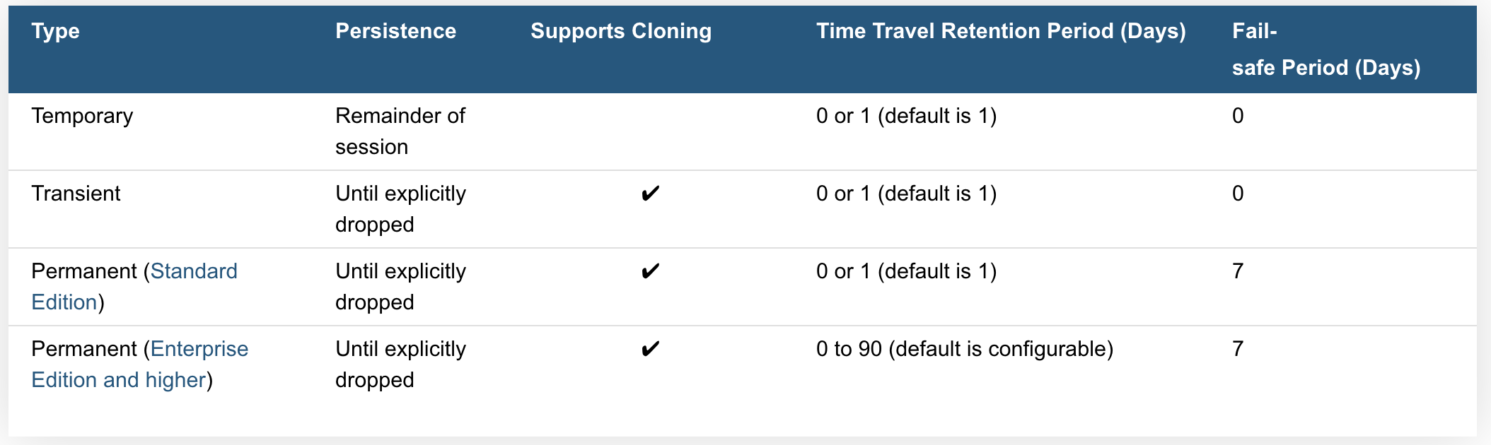
Working with Temp tables and Transient tables
Temporary Tables only exist within the session in which they were created. Once the session ends, data stored in the table is purged completely from the system
Transient Tables persist until explicitly dropped and are available to all users with the appropriate privileges. Transient tables are like permanent tables with the key difference that they do not have a Fail-safe period.
Notes:
Temp tables
transitory data (e.g. ETL data, session-specific data)
they are not visible to other users or sessions and do not support some standard features such as cloning.
is not recoverable, either by the user who created the table or Snowflake.
the data stored in the table contributes to the overall storage charges that Snowflake bills your account
Transient Tables
transient tables are specifically designed for transitory data that needs to be maintained beyond each session (in contrast to temporary tables), but does not need the same level of data protection and recovery provided by permanent tables.
Transient Databases and Schemas
Snowflake also supports creating transient databases and schemas. All tables created in a transient schema, as well as all schemas created in a transient database, are transient by definition.
Time Travel Notes
The Time Travel retention period for a table can be specified when the table is created or any time afterwards. Within the retention period, all Time Travel operations can be performed on data in the table (e.g. queries) and the table itself (e.g. cloning and restoration).
Temporary tables can have a Time Travel retention period of 1 day; however, a temporary table is purged once the session (in which the table was created) ends so the actual retention period is for 24 hours or the remainder of the session, whichever is shorter.
Fail-safe Notes
The Fail-safe period is not configurable for any table type.
Transient and temporary tables have no Fail-safe period. As a result, no additional data storage charges are incurred beyond the Time Travel retention period.

Slide 6

Working with Temp tables and Transient tables
Creating Temporary Tables simply specify the TEMPORARY keyword (or TEMP abbreviation) in CREATE TABLE
Creating Transient Tables, schemas, or databases are done by simply specifying the TRANSIENT keyword when creating the object:
create temporary table mytemptable (id number, creation_date date);
create transient table mytranstable (id number, creation_date date);
After creation, temporary and transient tables cannot be converted to any other table type
Notes:
transitory data (e.g. ETL data, session-specific data)
they are not visible to other users or sessions and do not support some standard features such as cloning.
is not recoverable, either by the user who created the table or Snowflake.
the data stored in the table contributes to the overall storage charges that Snowflake bills your account

Slide 7
Non-Materialized Views vs Materialized Views
Views usually refer to Non-Materialized Views
basically a named definition of a query
results are not stored for future use
Materialized views are named as though it were a type of view
Behave more like a table
Results are stored
Works well with unchanged base tables
Optimizes external tables
View has less rows than base table or
calculated field
CREATE [ OR REPLACE ] [ SECURE ]
MATERIALIZED VIEW [ IF NOT EXISTS ] <name> [ COPY GRANTS ] ( <column_list> ) [ COMMENT = '<string_literal>' ] [ CLUSTER BY ( <expr1> [, <expr2>
... ] ) ] AS <select_statement>
Notes:
Non materialized view
Selecting some (or all) columns in a table.
Selecting a specific range of data in table columns.
Joining data from two or more tables
Materialized views are designed to improve query performance for workloads composed of common, repeated query patterns. However, materializing intermediate results incurs additional costs. As such, before creating any materialized views, you should consider whether the costs are offset by the savings from re-using these results frequently enough.
Query results contain a small number of rows and/or columns relative to the base table (the table on which the view is defined).
Query results contain results that require significant processing, including:
Analysis of semi-structured data.
Aggregates that take a long time to calculate.
The query is on an external table (i.e. data sets stored in files in an external stage), which might have slower performance compared to querying native database tables.

Slide 8


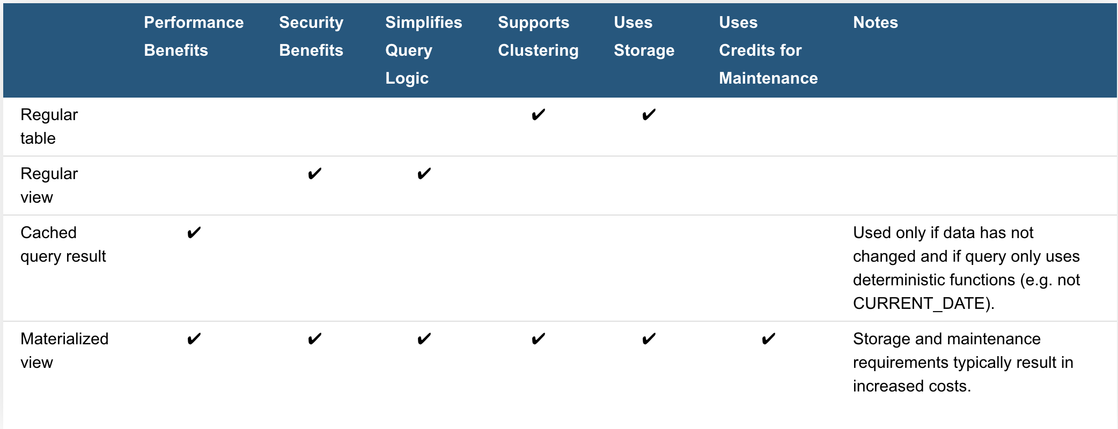
Advantages of Views
Secured views provide improved data privacy and data sharing
Both non-materialized and materialized views can be defined as secure
Views enable writing more modular code
Views allow you to grant access to just a portion of the data in a table(s)
Provide privileges based on data in each view
Views can improve performance
Notes:
Two use cases of modular code
suppose that your hospital database has a table listing information about all employees.
You can create views to make it convenient to extract information about only the medical staff or only the maintenance staff. You can even create hierarchies of views.
rather than writing one large and difficult-to-understand query, you can decompose the query into smaller pieces, and create a view for each of those pieces
Limitations on Views
The definition for a view cannot be updated (i.e. you cannot use ALTER VIEW or ALTER MATERIALIZED VIEW to change the definition of a view). To change a view definition, you must recreate the view with the new definition.
Changes to a table are not automatically propagated to views created on that table. For example, if you drop a column in a table, the views on that table might become invalid.
Views are read-only (i.e. you cannot execute DML commands directly on a view). However, you can use a view in a subquery within a DML statement that updates the underlying base table

Slide 9
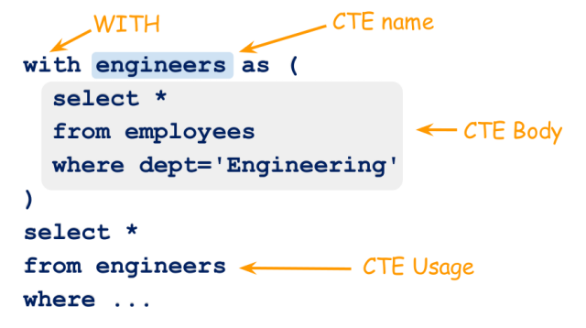
Common Table Expressions (CTE)s
A CTE is temporary named result set, derived from a simple query and defined within the execution scope of a SELECT, INSERT, UPDATE, or DELETE statement.
CTEs can be thought of as alternatives to derived tables (subquery), views, and inline user-defined functions.
Notes:
Benefits of CTE
CTE can be termed as 'Temporary View' used as a good alternative for a View in some cases.
The main advantage over a view is usage of memory.
As CTE's scope is limited only to its batch, the memory allocated for it is flushed as soon as its batch is crossed.
But once a view is created, it is stored until user drops it. If the view is not used after creation then it's a mere waste of memory.
CPU cost for CTE execution is lesser when compared to that of View.
Like View, CTE doesn't store any metadata of its definition and provides better readability.
A CTE can be referred for multiple times in a query.
As the scope is limited to the batch, multiple CTEs can have the same name which a view cannot have.
Using CTEs also has the benefit of allowing a developer to break up a very complex query into its component parts,
which can simplify the logic as well as assessment of exactly which joins dramatically affect performance
In addition, since the query is broken up into component parts, development, maintenance, and readability can be simplified greatly.
A CTE is defined to be a “temporary named result set, derived from a simple query and defined within the execution scope of a SELECT, INSERT, UPDATE, or DELETE statement.” “CTEs can be thought of as alternatives to derived tables (subquery), views, and inline user-defined functions.”

Slide 10
Common Table Expressions (CTE)s
CTE1
CTE2 select from CTE1
Select from CTE2 joining other tables
WITH PersonCTE (BusinessEntityID, FirstName, LastName) AS (SELECT Person.BusinessEntityID, FirstName, LastName FROM Person.Person WHERE LastName LIKE 'C%’),
PhoneCTE (BusinessEntityID, PhoneNumber)
AS (SELECT BusinessEntityID, PhoneNumber FROM Person.PersonPhone)
SELECT FirstName, LastName, PhoneNumber
FROM PersonCTE
INNER JOIN PhoneCTE
ON PersonCTE.BusinessEntityID = PhoneCTE.BusinessEntityID;
CTE1
CTE2
CTE3, which selects from CTE2 joining CTE1
Select from CTE3 joining other tables
CTE1
CTE2
Select from CTE2 joining CTE1 joining other tables
Notes:
Join ordering is extremely important because if a join creates a huge interim result set at the beginning of the query execution, SQL must continue to handle this result set until it can be trimmed down with filtering or additional join clauses. If this does not occur until the end of query execution, the query will usually perform poorly. However, if the number of records from a large table can be limited early in the execution or the join to the large table is added at the end of the query, the query will usually perform better. Therefore, when large tables are involved the ordering and the types of joins can dramatically affect the performance of a query. When multiple large tables are involved, it is often quite difficult to determine which one caused the poor performance
An extensively efficient way of making queries is to build complex queries gradually using the last layout, i.e., select from tables and gradually introduce joins while maintaining excellent performance
a very efficient form of the query can often be devised using only CTEs, sometimes, interim results must be stored in a temporary table, which is then joined with the large troublesome table
Does not force the ordering but can only help
Regardless, using a gradual approach to building queries with CTEs enables developers to understand exactly what the effect of every join is and therefore, create the most efficient query possible.

Slide 11

Common Table Expressions (CTE)s
A CTE (common table expression) is a named subquery defined in a WITH clause
think of the CTE as a temporary view
Non-Recursive – CTE does not reference itself
Will need two-level join for hierarchal data
Recursive - CTE that references itself
Think self joins on hierarchal data
Can create multiple joins without know how many levels are left
select emps.title, emps.employee_id, mgrs.employee_id as manager_id, mgrs.title as "MANAGER TITLE"
from employees as emps
left outer join employees as mgrs
on emps.manager_id = mgrs.employee_id
order by mgrs.employee_id nulls first,
emps.employee_id;
WITH [ RECURSIVE ] <cte_name>
AS
( <anchor_clause>
UNION ALL
<recursive_clause> )
SELECT ... FROM ...;
Notes:
Recursive CTE Considerations
Potential for Infinite Loops
In theory, constructing a recursive CTE incorrectly can cause an infinite loop. In practice, Snowflake prevents this by limiting the number of iterations that the recursive clause will perform in a single query. The MAX_RECURSIONS parameter limits the number of iterations.
To change MAX_RECURSIONS for your account, please contact Snowflake Support.
More Hierarchal data
In a two-level hierarchy (for example, managers and employees), the data can be queried with a two-way join
In a three-level hierarchy, you can use a 3-way join:
This concept can be extended to as many levels as needed, as long as you know how many levels are needed. But if the number of levels changes, the queries need to change.
Can also use connect by along with recursive CTEs

Slide 12

Why Do you need CTE’s?
Readability – CTE’s promote readability. Rather than lump all you query logic into one large query, create several CTE’s, which are the combined later in the statement. This lets you get the chunks of data you need and combine them in a final SELECT.
Substitute for a View – You can substitute a CTE for a view. This is handy if you don’t have permissions to create a view object or you don’t want to create one as it is only used in this one query.
Recursion – Use CTE’s do create recursive queries, that is queries that can call themselves. This is handy when you need to work on hierarchical data such as organization charts.
Limitations – Overcome SELECT statement limitations, such as referencing itself (recursion), or performing GROUP BY using non-deterministic functions.
Ranking – Whenever you want to use ranking function such as ROW_NUMBER(), RANK(), NTILE() etc.
Notes:
CTEs
All {{ ref('...') }} statements should be placed in CTEs at the top of the file
Where performance permits, CTEs should perform a single, logical unit of work.
CTE names should be as verbose as needed to convey what they do
CTEs with confusing or noteable logic should be commented
CTEs that are duplicated across models should be pulled out into their own models
CTEs should be formatted like this:
with
events as
(
...
),
-- CTE comments go here
filtered_events as
(
...
)
select * from filtered_events

Slide 13

CTE Style Guides
All {{ ref('...') }} statements should be placed in CTEs at the top of the file
CTEs should not perform multiple tasks… Keep it simple
Give CTEs verbose names that describe what they are doing
Comment all CTEs no matter how simple
Duplicate CTEs should have their own models
CTEs should follow this format :
with
events as
(
...
),
-- CTE comments go here
filtered_events as
(
...
)
select * from filtered_events

Slide 14

Hierarchal Data - Recursive CTE example
-- This is the WITH clause, of course.
with recursive managers
-- Column names for the "view"/CTE
(indent, employee_id, manager_id, employee_title)
as
-- Common Table Expression
( -- Anchor Clause
select '' as indent, employee_id, manager_id, title as employee_title
from employees
where title = 'President’
union all
-- Recursive Clause
select indent || '--- ‘,
employees.employee_id, employees.manager_id, employees.title
from employees
join managers
on employees.manager_id = managers.employee_id ) -- This is the "main select".
select indent || employee_title as title, employee_id, manager_id
from managers ;

Slide 15

Confused? ASK QUESTIONS

Slide 16
Break & Lab6
Notes:
Setting up a recursive CTE

